Slide 1
Strings
String is a collection of alphabets, words or other characters. It is one of the primitive data structures and are the building blocks for data manipulation.

Slide 2
How to create and print?
Strings can be output to screen using the print function.
For example: print("hello").
Strings can be created by enclosing characters inside a single quote or double quotes. Even triple quotes can be used in Python but generally used to represent multiline strings and docstrings.

Slide 3
Example:
my_string = 'Hello' print(my_string) my_string = "Hello" print(my_string) my_string = '''Hello''' print(my_string) # triple quotes string can extend multiple lines my_string = """Hello, welcome to the world of Python""" print(my_string)

Slide 4
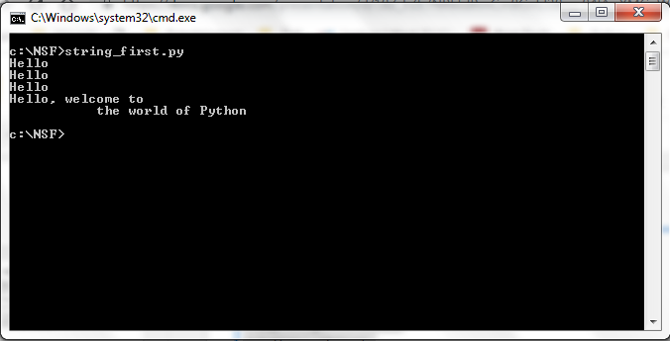
Output:

Slide 5
How to access characters in a string?
We can access individual characters using indexing and a range of characters using slicing. Index starts from 0. Trying to access a character out of index range will raise an IndexError. The index must be an integer. We can't use float or other types, this will result into TypeError.
Python allows negative indexing for its sequences. The index of -1 refers to the last item, -2 to the second last item and so on. We can access a range of items in a string by using the slicing operator (colon).

Slide 6
Example:
str = 'programiz' print('str = ', str) #first character print('str[0] = ', str[0]) #last character print('str[-1] = ', str[-1]) #slicing 2nd to 5th character print('str[1:5] = ', str[1:5]) #slicing 6th to 2nd last character print('str[5:-2] = ', str[5:-2])

Slide 7
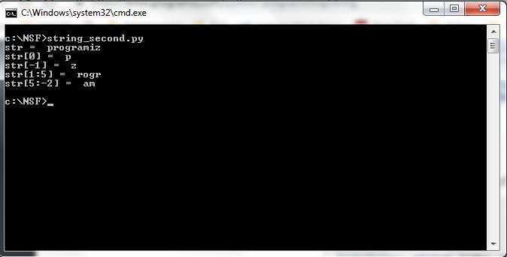
Output:

Slide 8
Slicing contd...
word = "Hello World" print word[0] #get one char of the word print word[0:1] #get one char of the word (same as above) print word[0:3] #get the first three char print word[:3] #get the first three char print word[-3:] #get the last three char print word[3:] #get all but the three first char print word[:-3] #get all but the three last character

Slide 9
More understanding slicing
word = "Hello World" word[start:end] # items start through end-1 word[start:] # items start through the rest of the list word[:end] # items from the beginning through end-1 word[:] # a copy of the whole list

Slide 10
Testing Strings...
A string in Python can be tested; the return type will be in Boolean value (True or False) For eg: in word = "Hello World" word.isalnum() #check if all char are alphanumeric word.isalpha() #check if all char in the string are alphabetic word.isdigit() #test if string contains digits word.isupper() #test if string contains upper case word.islower() #test if string contains lower case word.isspace() #test if string contains spaces word.endswith('d') #test if string endswith a d word.startswith('H') #test if string startswith H

Slide 11
Strip
Python strings have the strip(), lstrip(), rstrip() methods for removing any character from both ends of a string. If the characters to be removed are not specified then white-space will be removed.
strip() #removes from both ends lstrip() #removes leading characters (Left-strip) rstrip() #removes trailing characters (Right-strip)

Slide 12
Example:
# Has two leading spaces and a trailing one. value = " a line " # Remove left spaces. value1 = value.lstrip() print("[" + value1 + "]") # Remove right spaces. value2 = value.rstrip() print("[" + value2 + "]") # Remove left and right spaces. value3 = value.strip() print("[" + value3 + "]")

Slide 13
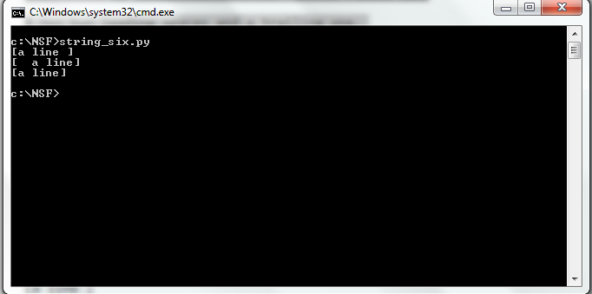
Output

Slide 14
String Methods like .upper() and .lower()
The .upper() and .lower() string methods are self-explanatory. Performing the .upper() method on a string converts all of the characters to uppercase, whereas the lower() method converts all of the characters to lowercase.
Same way .isupper() and .islower() returns the boolean value after checking the string.
Let’s see one example here

Slide 15
Example
string = "North South Foundation"
#Change the string to UPPERCASE print(string.upper()) #Change the string to lowercase print(string.lower()) #Check if string is in uppercase or not print(string.isupper()) #Check if string is in lowercase or not print(string.islower())

Slide 16
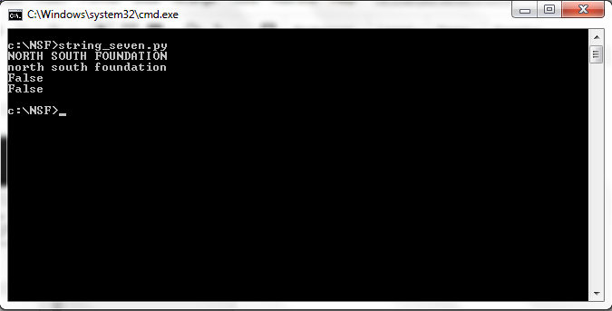
Output

Slide 17
String Operations
Concatenation of Two or More Strings
Joining of two or more strings into a single one is called concatenation. The + operator does this in Python. Simply writing two string literals together also concatenates them. The * operator can be used to repeat the string for a given number of times.

Slide 18
Example:
str1 = 'Hello' str2 ='World!' # using + print('str1 + str2 = ', str1 + str2) # using * print('str1 * 3 =', str1 * 3)

Slide 19
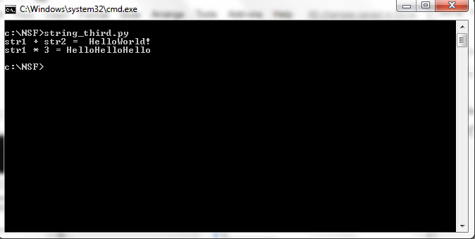
Output

Slide 20
Iterating Through String
Using for loop we can iterate through a string. Here is an example to count the number of 'l' in a string.
Example:
count = 0 for letter in 'Hello World': if(letter == 'l'): count += 1 print(count,'letters found')

Slide 21
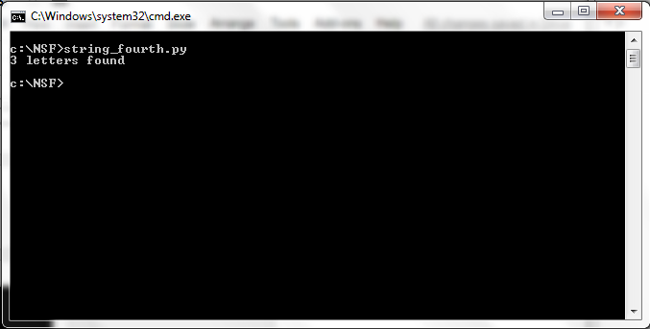
Output

Slide 22
Built-in functions to work with
Various built-in functions that work with sequence, works with string as well. Some of the commonly used ones are enumerate() and len(). The enumerate() function returns an enumerate object. It contains the index and value of all the items in the string as pairs. This can be useful for iteration. Similarly, len() returns the length (number of characters) of the string.

Slide 23
Example:
str = 'cold' # enumerate() list_enumerate = list(enumerate(str)) print('list(enumerate(str) = ', list_enumerate) #character count print('len(str) = ', len(str))

Slide 24
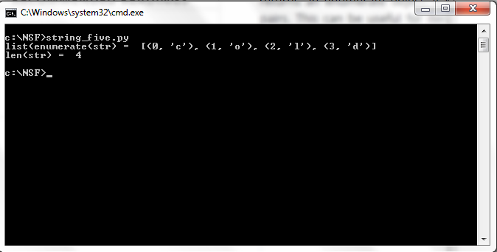
Output:

Slide 25
Example covering major string functions
#Accessing Values in Strings var1 = "North South Foundation!" var2 = "Software Testing" print ("var1[0]:",var1[0]) print ("var2[1:5]:",var2[1:5]) #Some more examples x = "Hello World!" print (x[:6]) print (x[0:6] + "NSF") #Python String replace() Method oldstring = 'I like Python' newstring = oldstring.replace('like', 'love') print (newstring)

Slide 26
#Changing upper and lower case strings string="python at NSF" print (string.upper()) string="PYTHON AT NSF" print (string.lower()) #Using "join" function for the string print (":".join("Python")) #Reversing String string="12345" print (''.join(reversed(string))) #Split Strings word="North South Foundation" print (word.split(' ')) word="North South Foundation" print (word.split('r')) x = "JavaScript" x.replace("JavaScript","Python") print (x)

Slide 27
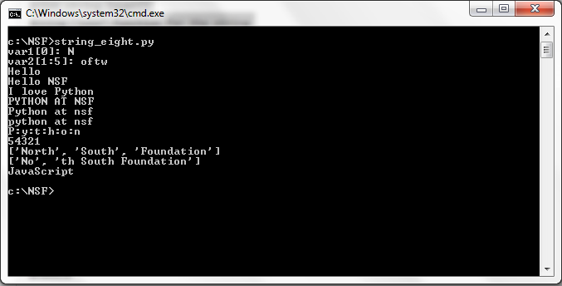
Output

